Slide 1
FIRST PRINCIPLES WORKED EXAMPLE
POWER RULE WORKED EXAMPLE
First Principles is used to find the slope of the tangent at any given point. It is a formula that shows the first derivative, a function that represents the gradient (slope) of another function.
The Power Rule is used to differentiate terms and is a fundamental process involved in other rules of differentiation, like the quotient and product rule. The Power Rule is always applied to a term in this process.
FIND THE FIRST DERVIATIVE OF x²+5x+6 AND HENCE, THE F’(3)
DIFFERENTIATE 6x⁴
The exponent is brought down to the number next to the co-efficient. These two numbers are then multiplied together (the coefficient and the exponent) to get the product of these two integers. Sometimes, an exponent or co-efficient may be fraction, the same process still occurs, refer to multiplying fractions for more guidance.
1 is then subtracted from the exponent.
Substitute values into the equation, the f(x+h) simply means that wherever there is an x, it is replaced by an x+h. This is based on the idea of using the common slope formula and some distance between two points, x and an x+h value, where h is approaching a distance of 0.
Expand the bracketed terms using law of expansion x²+2xh+h² can be expanded from (x+h)²
Numbers and values are then simplified accordingly in order to find the derivative of the term.
This means that the function 6x⁴ has a derivative of 24x³, which is a function that represents another function.
Terms are then simplified. All terms without a h should cancel.
We can not let h=0 yet, as this would result in the denominator being 0, hence we must isolate all h values from the numerator.
Then h can go to zero and there is our answer
Here is another example with fractional and surd values, the same process is applied
This means that 2x+5 represents the slope of the original function

Slide 2
POWER RULE WORKED EXAMPLE
SUM RULE WORKED EXAMPLE
The Power Rule is used to differentiate terms and is a fundamental process involved in other rules of differentiation, like the quotient and product rule. The Power Rule is always applied to a term in this process.
The sum rule states that if two or more terms are added or subtracted then their derivatives can be found by applying the power rule to each term individually. Refresh your knowledge on the power rule before this.
DIFFERENTIATE x⁴
DIFFERENTIATE x⁴+3x⁵-2x⁷
The exponent is simply brought to the position of the co-efficient and one is subtracted from the exponent.
The exponent is simply brought to the position of the co-efficient (and multiplied by the co-efficient if there was a co-efficient in from of the term) and one is subtracted from the exponent. This is done for all terms in this equation.
Here is another example with fractional and surd values, the same process is applied
Note that (7/2) – 1 is 5/2
Simplification can then occur across this function by simply performing the operations mentioned.
The formula is based on where n is some value and x is the pronumeral or input value for a function.
It is quite simple, it is just a matter of moving a value and subtracting. Be careful to subtract fractions correctly though. Simplify surds were possible for easier calculations in multiple part questions. Sometimes, you may need to leave it in sqrt(2) -1 form to have the most elegant solution, this is what I have done above.
This also works for functions with surds and equations too. An example involving fractions is below:

Slide 3
QUOTIENT RULE WORKED EXAMPLE
PRODUCT RULE WORKED EXAMPLE
Quotient Rule is a rule of differentiation. For this, one simply follows the general form to differentiate two terms that are separated by a divisor bar. Power Rule is used to differentiate as appropriate for general form.
Product Rule is applied to differentiate two terms that are multiplied to each other. Sometimes you may need to apply product rule in quotient rule or sum rule, hence why it is important to understand these too.
Use quotient rule to find the derivative
Use product rule to find the derivative
Let’s say the following was what we had to differentiate. The g(x) term is the numerator and the h(x) term is the denominator. Differentiate the terms separately to plug them into quotient rule as appropriate. Use sum and power rule.
Similar process to quotient rule, one needs to identify what the two terms are that have been multiplied together, once doing this, they simply differentiate both terms and plug them into the equation based on general form.
Now to one simply writes the derivative of g(x) first, multiplied by h(x) as is, then a subtract symbol and the g(x) as is with the derivative of the h(x) as a product. Remember to watch for double negatives when doing this.
Lastly, this will all be over the denominator as it was before, however this time it will be raised to the power of two. If you are still having difficulty, recap on the sum and power rule, and notice that 15x¹ will result in a derivative of 15x⁰ and anything raised to the power of zero is of course 1, hence why the second term in h’(x) is 15.
To do this, one would simply apply power rule to differentiate as shown by bringing the exponent down to the co-efficient to find the product of those two numbers, before subtracting one from the exponent.
Then, the first term differentiated is then multiplied by the second term as is, before a sum operation, after this, the derivative of the second term is then multiplied by the first term as is. Hence, one achieves the following result.
Again, when you are differentiating, you may need to work with surds and fractions in order to complete the process, it is important to perform these simple arithmetic operations correctly in order to find the correct answer.

Slide 4
LNX RULE WORKED EXAMPLES
EULER’S RULE WORKED EXAMPLES
Differentiating ln(x) generally results in two fundamental rules. The first is if a derivative of ln (x) is needed, in which case, it can be expressed simply as 1/x. If a term is in the form of ln f(x), then it is simply f’(x)/f(x)
This focuses on all of the Eulers Rule Differentiation laws involving e. e^{x} is the only function whose derivative is itself. There are a few other laws, like e^{f(x)} and ke^{f(x)}, which also make differentiation a breeze.
Find the f’(ln |x²+17x+9|)
Find the f’(e^{2x+5})
The lines around the second degree polynomial are simply modulus symbols. This means that values must be positive as a scalar, a property of ln. In order to do this, one would simply differentiate and then put the derivative in the numerator and the function as is in the denominator. Sometimes you can cancel, remember that terms only cancel across numerator or denominator if the operation between one term and the next is multiply and not add or subtract.
In order to differentiate, we rewrite the function without changing anything. After this, we differentiate the exponent. In this case, the derivative of 2x+5 is 2 as 5 is a constant and hence does not have a derivative (think of the function y=5, it is a horizontal line and as such, there is no change in the input relative to the output). This is how we obtain the derivative.
Find the f’(5e^{2x+5})
Furthermore, a resultant of this rule, is that if a function is in the form of f(x)= ln |kx|, where k is some constant, then the result after simplification is simply 1/x. Try this with a few, you can see that as the derivative of kx is k and it is divided by the product of k and x, then result can be expressed by 1/x.
Anyway, back to our worked result problem, let me differentiate the polynomial in the modulus symbols first. For this, I am going to generalise the value in the modulus after ln to be g(x).
Now, as you can see above, there is an extension to this rule which involves a co-efficient of e. In this case, the number, generally denoted by k as a constant (unless it has an x or pronumeral in it), will remain out the front and is multiplied by the value derived through the f’(x) phase for the exponent, where the derivative of the exponent and the co-efficient of e make a product in simplification, this is shown by 5 being multiplied by 2 (2 being from the derivative of the exponent). If the derivative of the exponent was 15x or something, then you could still multiply this by the co-efficient to get 30x and have a more elegant solution too.
Hopefully you can see how I applied Power Rule there. I then simply substitute according to
Again, you may need to work with fractions and surds too.

Slide 5
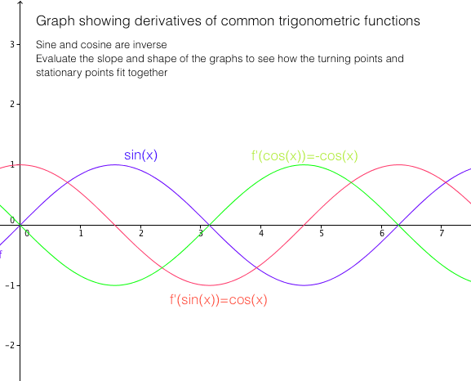
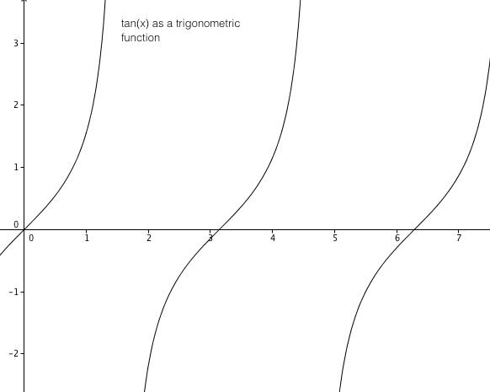
TRIGONOMETRIC FUNCTION DERIVATIVES
CHAIN RULE WORKED EXAMPLE
The Chain Rule is a rule of differentiation used to find the derivative of a function within another function. This is generally used when one term is bracketed and raised to an exponential power.
DIFFERENTIATE (6x)²
In order to differentiate, one must first bring the exponent to the position out the front of the bracket. This is differentiating the “exponent term” and after this exponent has been moved out the front, you can simply rewrite the term in the bracket as is and subtract one from the exponent.
After this, the derivative of what is in the bracket is then multiplied by the rest of the function, hence the result looks like:
One can then simplify by getting the product of the constants and removing the exponent as the result is to the power of 1. This can then be simplified again using the distributive law.
One can also be expected to work with surds and fractions for chain rule. An example involving both surds and fractions can be seen below. Again power rule and chain rule are applied:

